Slide 1
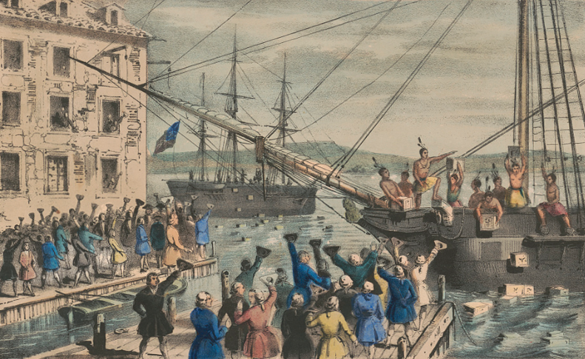
Trouble in the Colonies
Part 2-
Colonial Resistance Grows

Slide 2
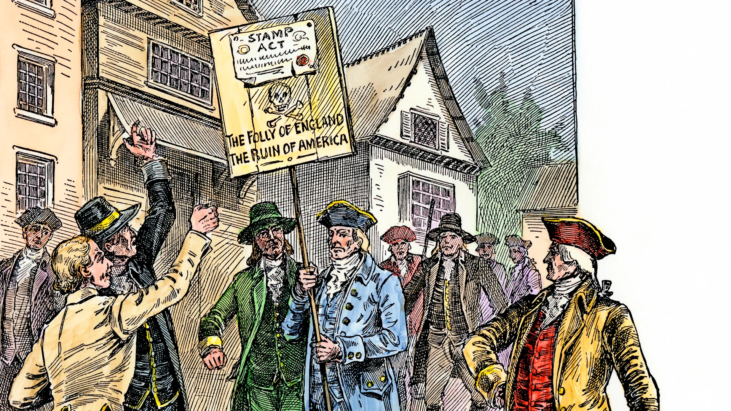
Britain continued to need money to pay for the debt it was in from the Seven Years’ War. The Stamp Act didn’t work, and the Quartering Act wasn’t being followed.

Slide 3
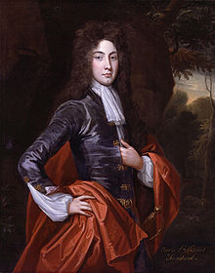
In 1767, Parliament passed the Townsend Act. It was named after the king’s finance minister Charles Townsend.

Slide 4
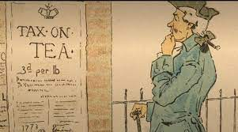
The goal of the Townsend Act was to raise money by taxing goods like glass, paper, paint, lead and tea brought into the colonies.

Slide 5
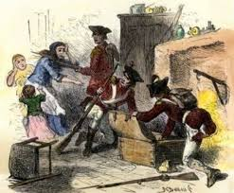
The Townsend Act was enforced by officials using writs of assistance. A writ of assistance was a legal paper giving British officers the right to search any building for any reason.

Slide 6
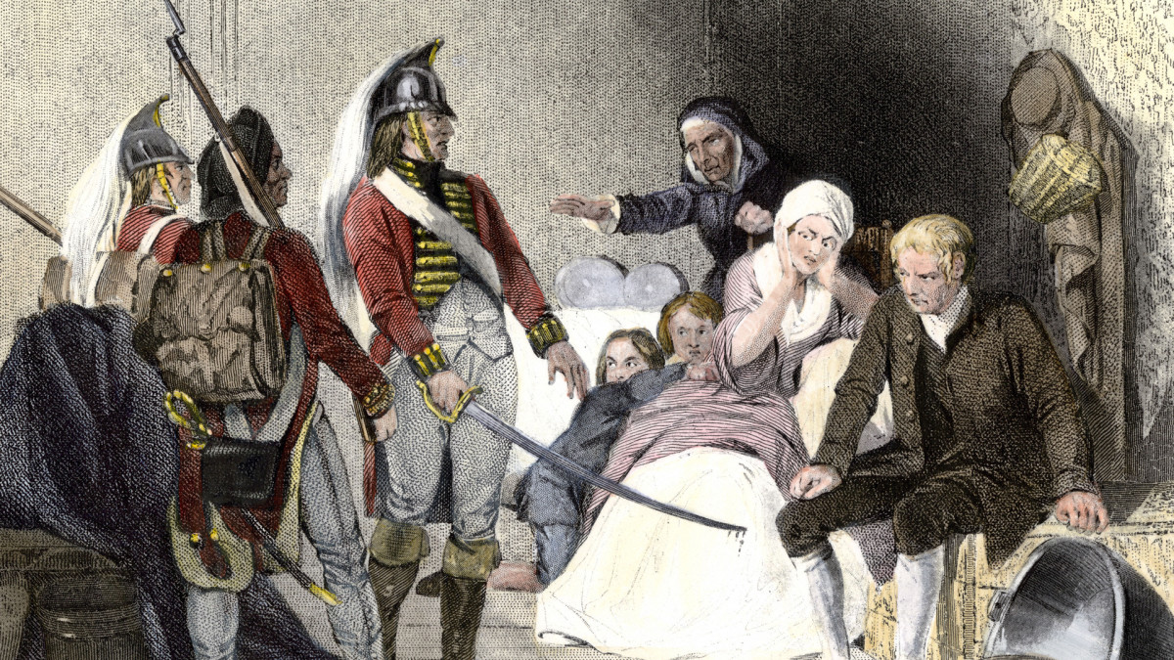
The Townsend Act also suspended New York’s assembly until they met the demands of General Gage to house British soldiers.

Slide 7
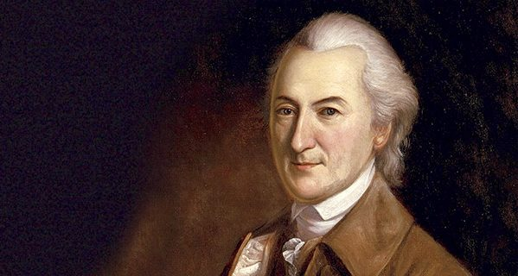
Many colonists were upset and protested. John Dickinson of Pennsylvania wondered, “whether Parliament can legally take money out of our pockets without our consent.”

Slide 8
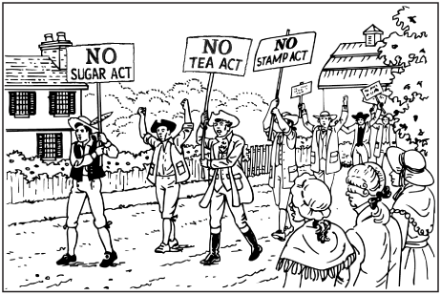
One way colonists protested was to boycott British goods. To boycott means to refuse to buy something.

Slide 9
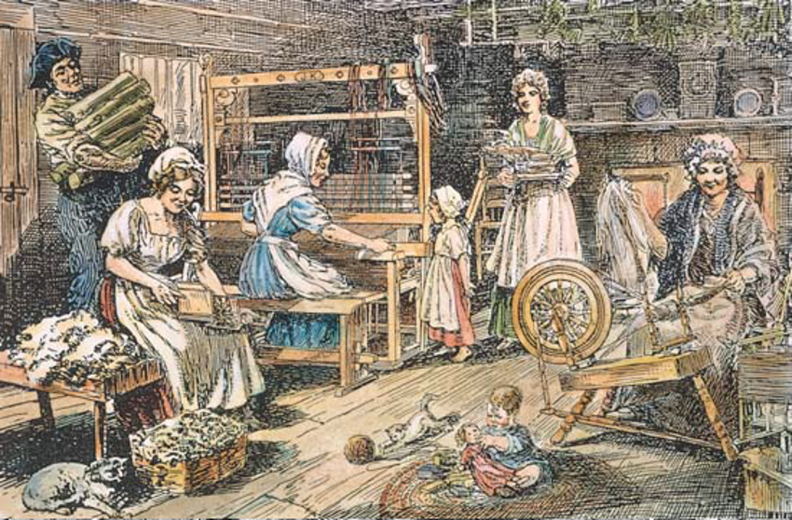
Trade between Britain and the colonies dropped sharply, hurting British merchants financially. This also emphasized the importance of buying American-made goods.

Slide 10
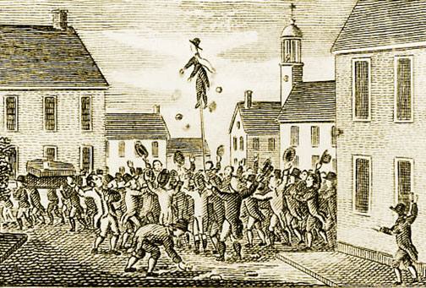
The Sons of Liberty were very active in organizing protests and boycotts. Boston, Massachusetts, became an area of extreme tension.

Slide 11
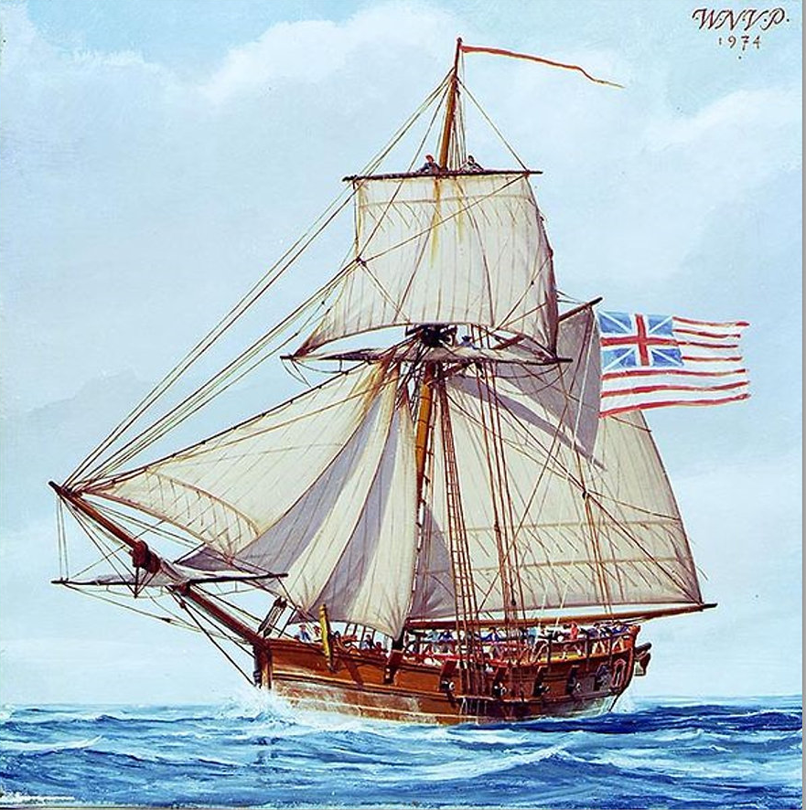
One incident that occurred had to do with the merchant ship Liberty. John Hancock of Boston owned the ship. The Liberty carried smuggled goods from Portugal.

Slide 12
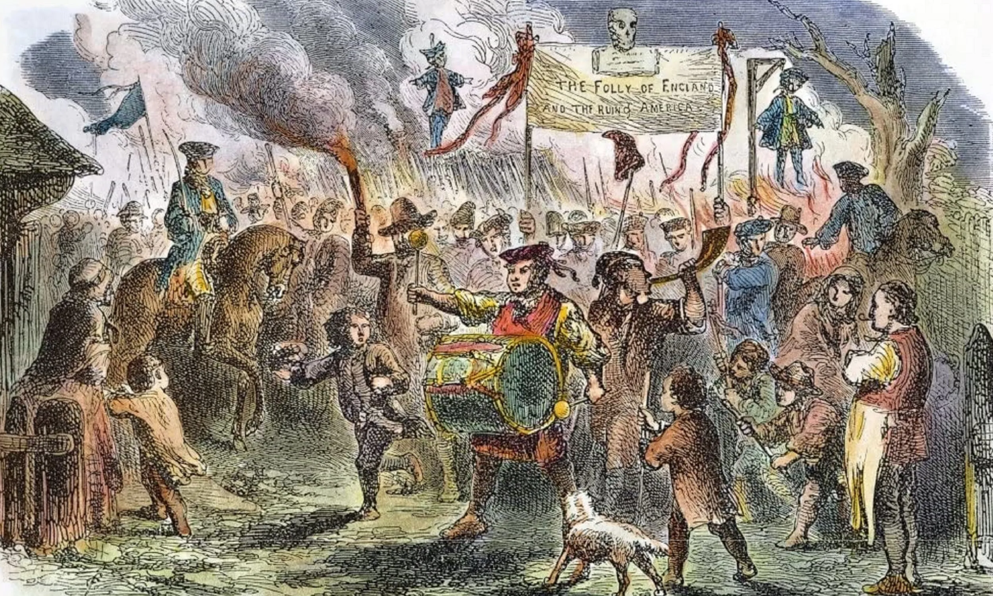
On one trip in 1768 the Liberty carried smuggled goods from Portugal. When custom officials tried to seize the ship, a riot broke out and the officials were forced to flee to safety.

Slide 13
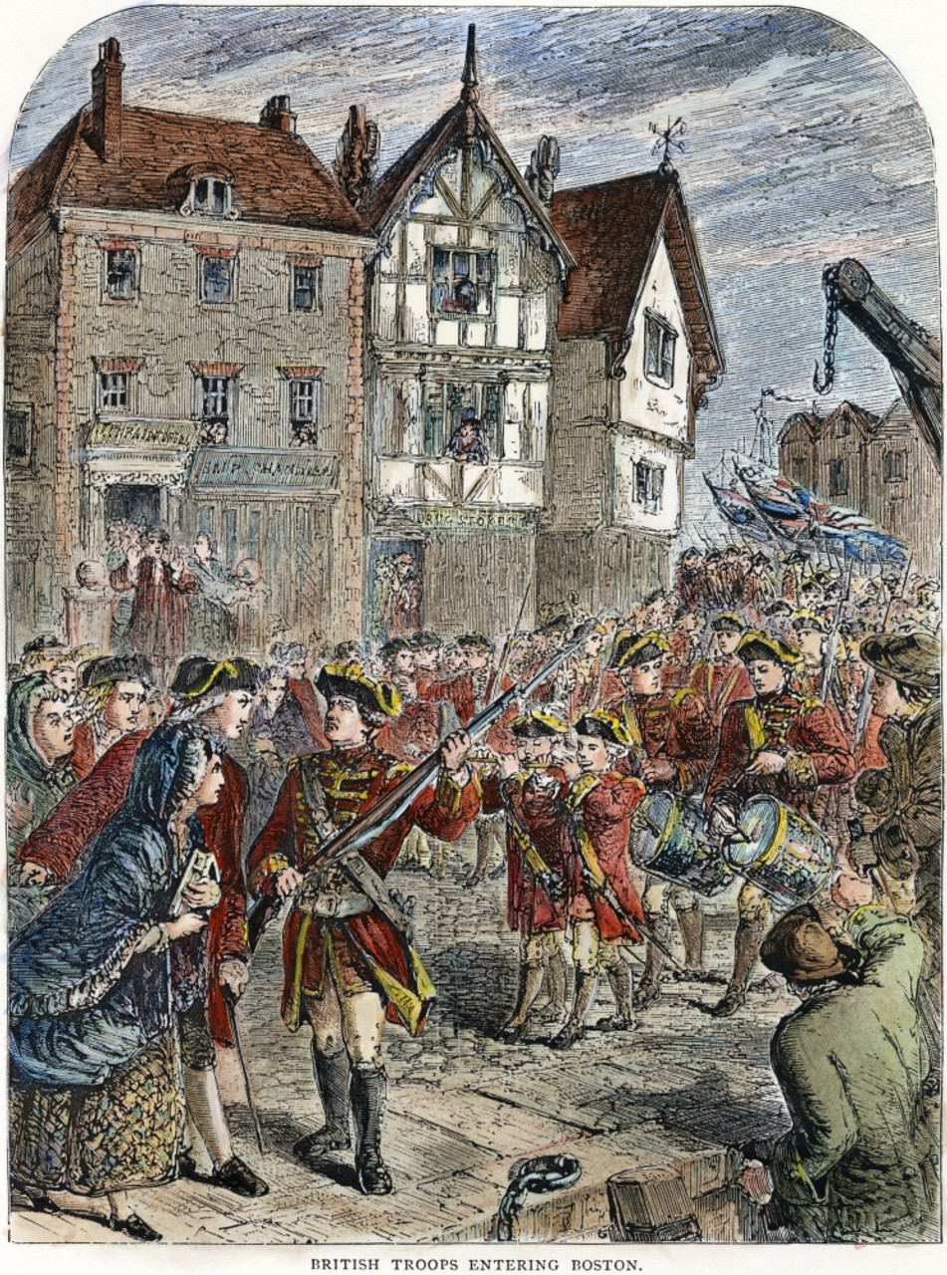
After the incident with the Liberty, 1,000 British soldiers led by General Thomas Gage were sent to Boston to keep order. This infuriated many colonists even more.

Slide 14
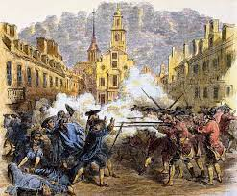
Tensions grew to the point of deadly violence. What would become known as the Boston Massacre took place on March 5, 1770.

Slide 15
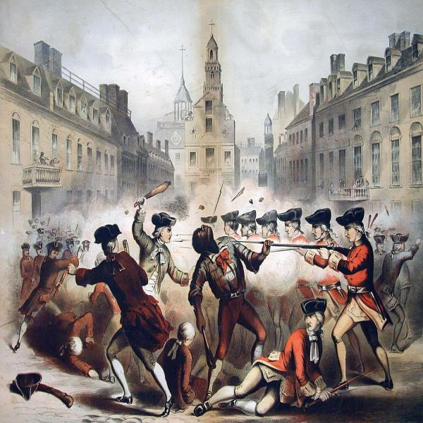
The Boston Massacre occurred when British soldiers in Boston fired their guns at a group of protesters in front of the Boston Customhouse. Five colonists were killed.

Slide 16
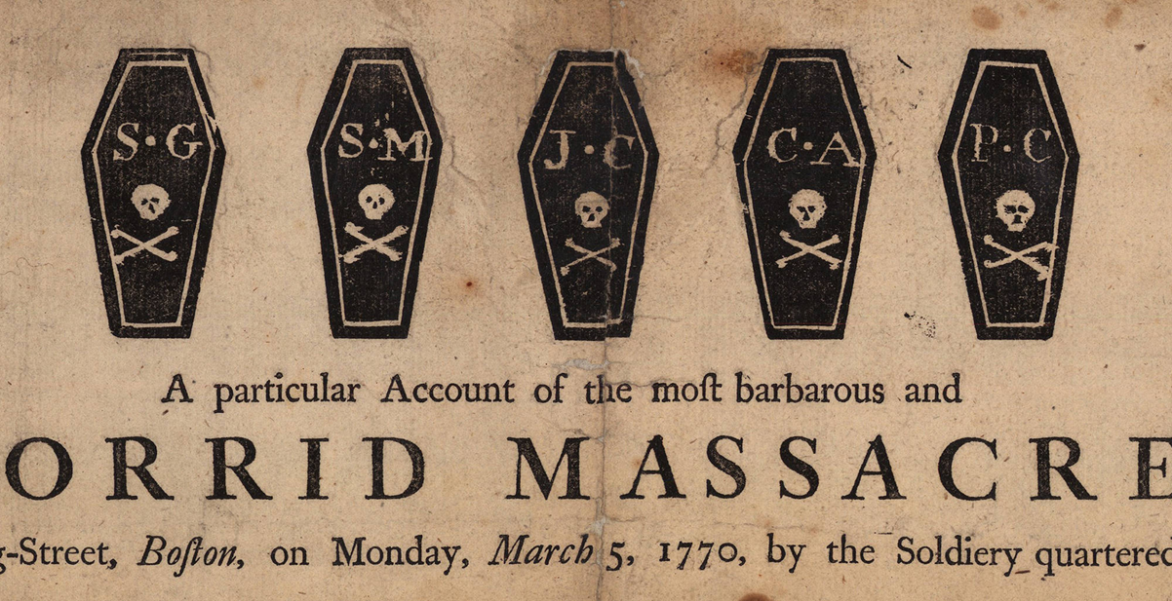
Think About It
Why do you think this was called a massacre?
Propaganda

Slide 17
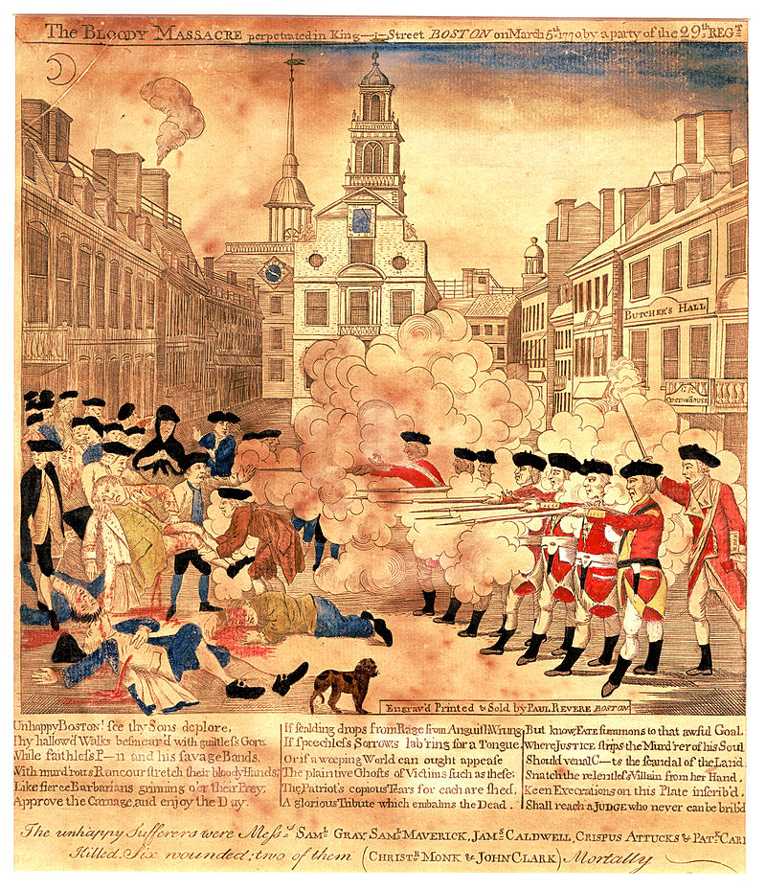
The Sons of Liberty used this incident to try to influence people’s thinking to go against the British. They tried to show the dangers of having British soldiers in colonial towns.

Slide 18
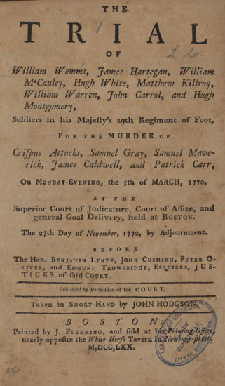
The soldiers were arrested and tried for murder. Lawyers John Adams and Josiah Quincy, Jr. defended them. Six of the soldiers were cleared of wrongdoing, while two of them had their thumbs branded as a penalty for the shooting.

Slide 19
Exit Question
Why do you think John Adams, who would go on to be one of our country’s founding fathers and second president of the United States defend the British soldiers?
He said, “the law should be deaf…to the clamors of the populace.”

